Slide 1
Bachelor of Engineering(Computer Science and Engineering)
Networking
Submitted to
Er. inderjeet
singh
Submitted by
Simranjeet Saini

Slide 2
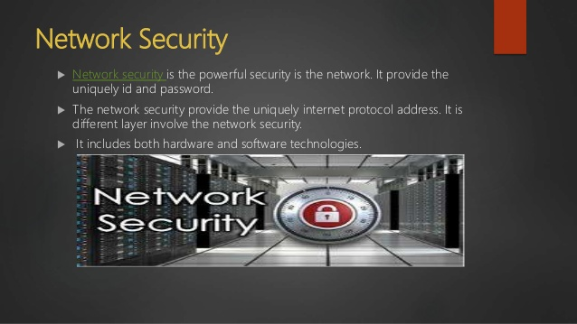
NETWORK SECURITY OVER INTERNET

Slide 3
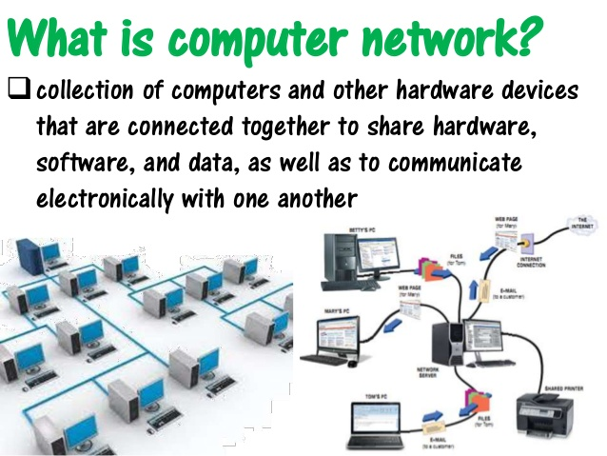
WHAT IS NETWORK

Slide 4
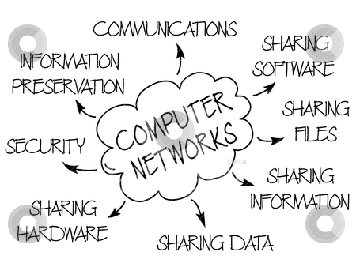
ADVANTAGES OF NETWORK

Slide 5
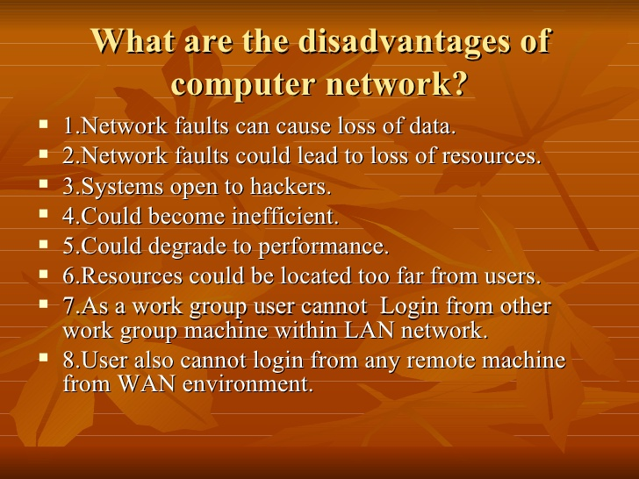
DISADVANTAGES OF NETWORK

Slide 6
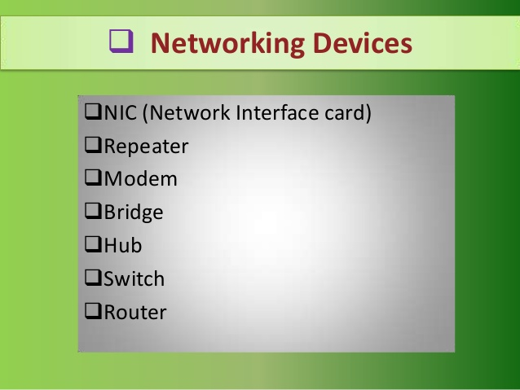
NETWORK DEVICES

Slide 7
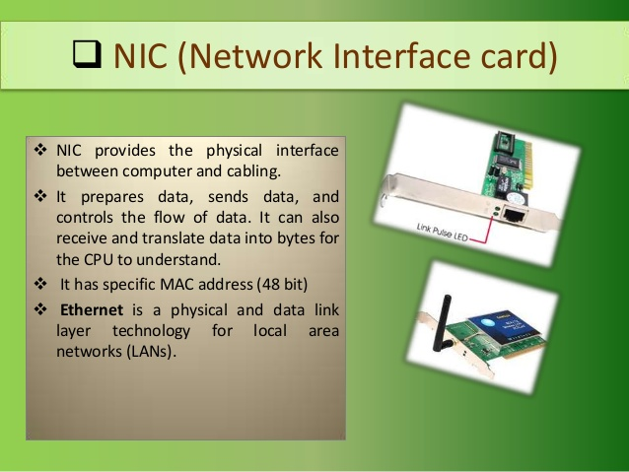
NETWORK INTERFACE CARD

Slide 8
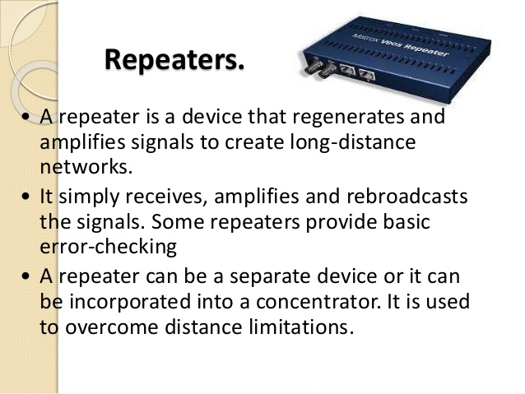
REPEATER

Slide 9
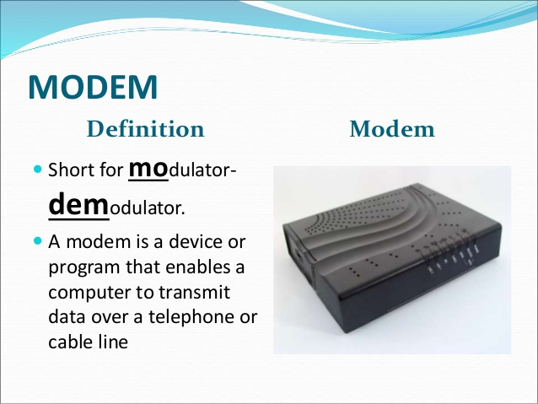
MODEM

Slide 10
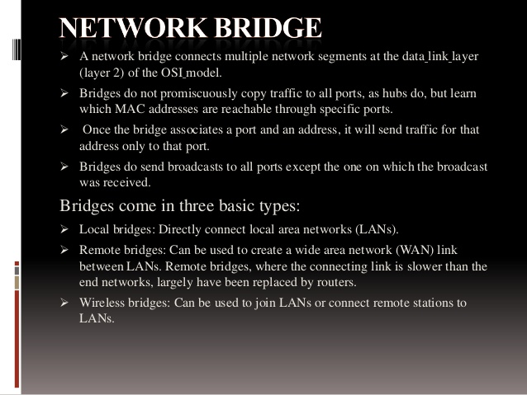
BRIDGE

Slide 11
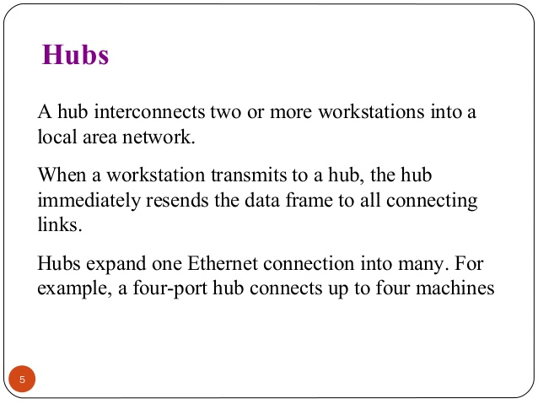
HUB

Slide 12
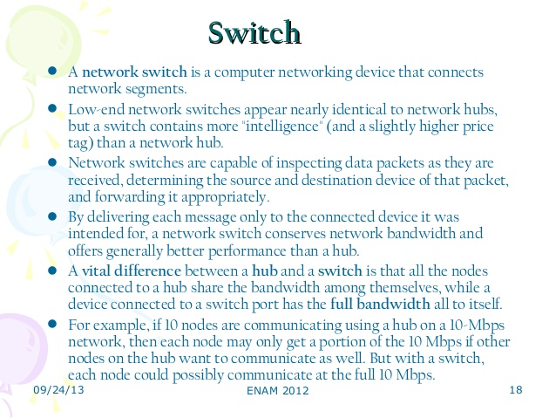
SWITCH

Slide 13
ROUTER
A router is a networking device that forwards data packets between computer networks. Routers perform the traffic directing functions on the Internet. A data packet is typically forwarded from one router to another router through the networks that constitute the internetwork until it reaches its destination node.

Slide 14
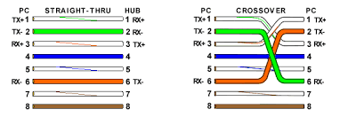
NETWORKS CABLES

Slide 15
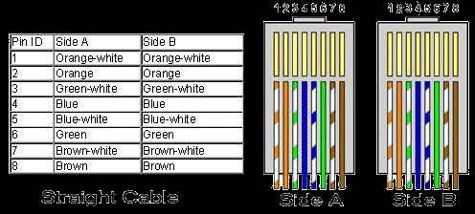
STRAIGHT CABLE

Slide 16
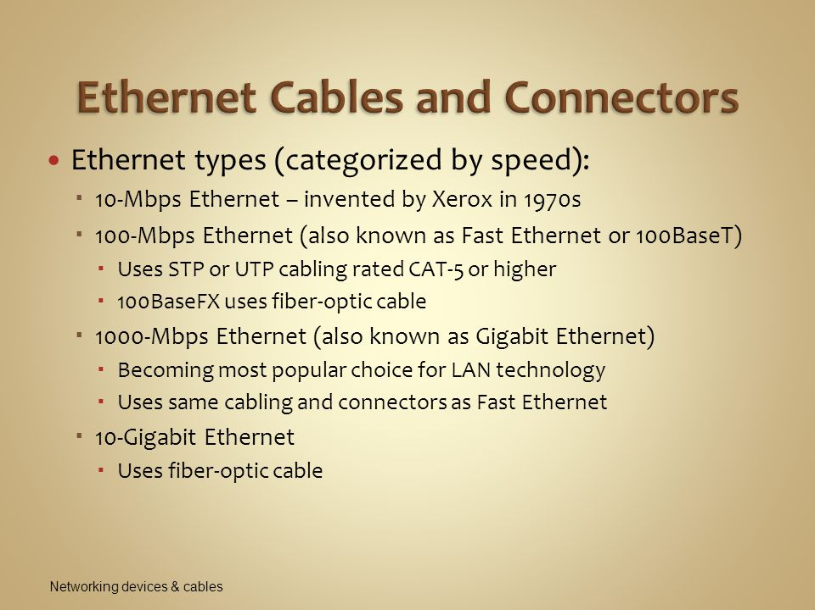
ETHERNET CABLES

Slide 17
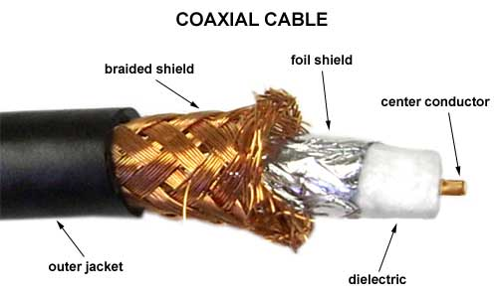
COAXIAL CABLE

Slide 18
CONNECTORS
The part of a cable that plugs into a port or interface to connect one device to another. Most connectors are either male (containing one or more exposed pins) or female (containing holes in which the male connector can be inserted).

Slide 19
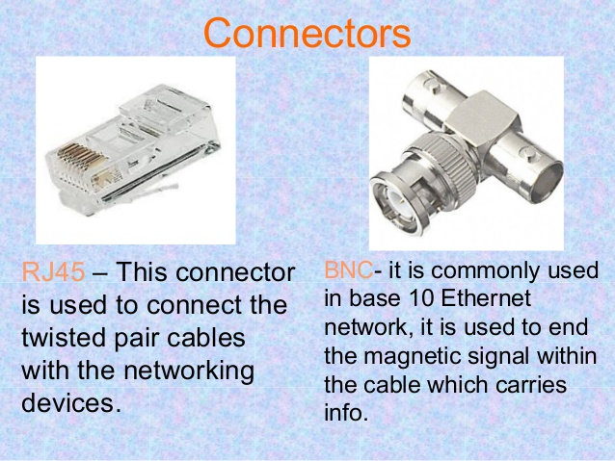
TYPES OF CONNECTORS

Slide 20
SERIAL CABLE
A serial cable is a cable used to transfer information between two devices using a serial communication protocol. The form of connectors depends on the particular serial port used. A cable wired for connecting two DTEs directly is known as a null modem cable.

Slide 21
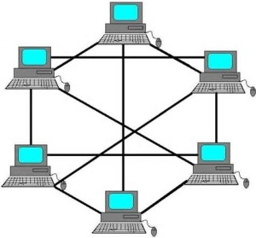
NETWORK TOPOLOGY
A mesh network is a network topology in which each node relays data for the network. All mesh nodes cooperate in the distribution of data in the network. It can be applied to both wired and wireless networks.

Slide 22
ROUTING RIP
The Routing Information Protocol (RIP) is one of the oldest distance-vector routing protocols which employ the hop count as a routing metric. RIP prevents routing loops by implementing a limit on the number of hops allowed in a path from source to destination. The maximum number of hops allowed for RIP is 15, which limits the size of networks that RIP can support. A hop count of 16 is considered an infinite distance and the route is considered unreachable. RIP implements the split horizon, route poisoning and holddown mechanisms to prevent incorrect routing information from being propagated.ROUTING INFORMATION PROTOCOL

Slide 23
OPEN SHORTEST PATH FIRST
Open Shortest Path First (OSPF) is a routing protocol for Internet Protocol (IP) networks. It uses a link state routing (LSR) algorithm and falls into the group of interior gateway protocols (IGPs), operating within a single autonomous system (AS). It is defined as OSPF Version 2 in RFC 2328 (1998) for IPv4.

Slide 24
Enhanced Interior Gateway Routing Protocol (EIGRP)
Enhanced Interior Gateway Routing Protocol (EIGRP) is an advanced distance-vector routing protocol that is used on a computer network for automating routing decisions and configuration. The protocol was designed by Cisco Systems as a proprietary protocol, available only on Cisco routers.

Slide 25
WEB SERVER
A Web server is a program that uses HTTP (Hypertext Transfer Protocol) to serve the files that form Web pages to users, in response to their requests, which are forwarded by their computers' HTTP clients. Dedicated computers and appliances may be referred to as Web servers as well.

Slide 26
DNS SERVER
A DNS server is a computer server that contains a database of public IP addresses and their associated hostnames, and in most cases, serves to resolve, or translate, those common names to IP addresses as requested. DNS servers run special software and communicate with each other using special protocols.

Slide 27
ACCESS LIST SECURITY
An access control list (ACL), with respect to a computer file system, is a list of permissions attached to an object. An ACL specifies which users or system processes are granted access to objects, as well as what operations are allowed on given objects.[1] Each entry in a typical ACL specifies a subject and an operation. For instance, if a file object has an ACL that contains (Alice: read,write; Bob: read), this would give Alice permission to read and write the file and Bob to only read it.

Slide 28
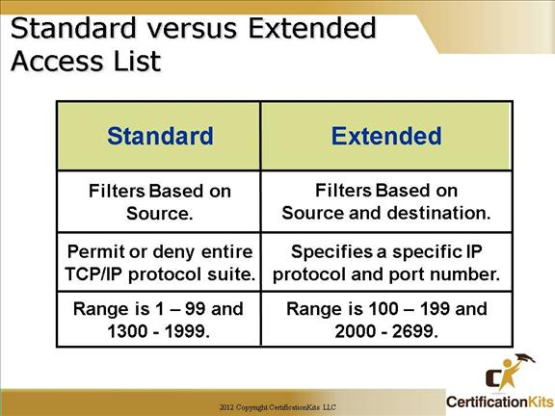
STANDARD ACCESS CONTROL LIST

Slide 29
NETWORK ADDRESS TRANSLATION
Network address translation (NAT) is a method of remapping one IP address space into another by modifying network address information in Internet Protocol (IP) datagram packet headers while they are in transit across a traffic routing device.[1] The technique was originally used for ease of rerouting traffic in IP networks without readdressing every host. In more advanced NAT implementations featuring IP masquerading, it has become a popular and essential tool in conserving global address space allocations in face of IPv4 address exhaustion by sharing one Internet-routable IP address of a NAT gateway for an entire private network.

Slide 30
STATIC NAT
A type of NAT in which a private IP address is mapped to a public IP address, where the public address is always the same IP address (i.e., it has a static address). This allows an internal host, such as a Web server, to have an unregistered (private) IP address and still be reachable over the Internet.

Slide 31
DYNAMIC NAT
Dynamic NAT translates a group of real addresses to a pool of mapped addresses that are routable on the destination network. The mapped pool may include fewer addresses than the real group. When a host you want to translate accesses the destination network, the ASA assigns the host an IP address from the mapped pool.

Slide 32
PORT ADDRESS TRANSLATION
Port address translation (PAT) is a function that allows multiple users within a private network to make use of a minimal number of IP addresses. Its basic function is to share a single IP public address between multiple clients who need to use the Internet publicly.

Slide 33
THANK YOU

